Slide 1
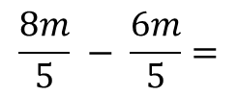
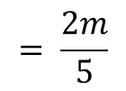
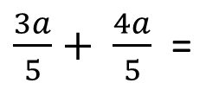
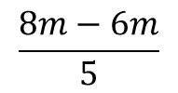
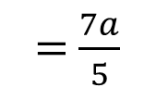
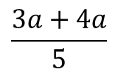
24
7
30
Date
Add and Subtract Algebraic Fractions
EQ – How do I Simplify when Adding & Subtracting Algebraic Fractions?
$\frac{3a}{5}+ \frac{4a}{5}$ =
$$\frac{3a+4a}{5}$$
Don’t forget you must have a common denominator, then add the top line.
= $\frac{7a}{5}$
Note: don’t make it a mixed numeral
$$\frac{8m}{5} − \frac{6m}{5}=$$
$$\frac{8m−6m}{5}$$
Similar to Addition don’t forget you must have a common denominator, then subtract the the top line.
$$= \frac{2m}{5}$$

Slide 2
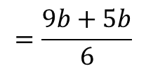
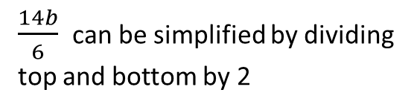
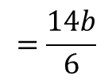
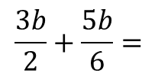
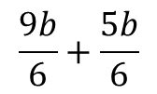
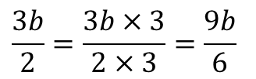
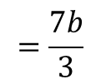
24
7
30
Date
Add and Subtract Algebraic Fractions
EQ – How do I Simplify when Adding & Subtracting Algebraic Fractions?
Remember: Must be over a common denominator.
$$\frac{3b}{2}+\frac{5b}{6}=$$
$$\frac{9b}{6}+\frac{5b}{6}$$
$$\frac{3b}{2}=\frac{3b×3}{2×3}=\frac{9b}{6}$$
$$=\frac{9b+5b}{6}$$
$$=\frac{14b}{6}$$
$$=\frac{7b}{3}$$
$\frac{14b}{6}$ can be simplified by dividing top and bottom by 2

Slide 3
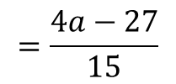

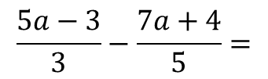

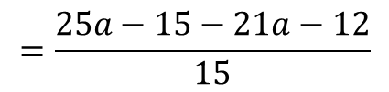
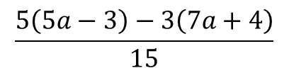
24
7
30
Date
Add and Subtract Algebraic Fractions
EQ – How do I Simplify when Adding & Subtracting Algebraic Fractions?
Don’t forget the - sign
$$\frac{5a−3}{3}−\frac{7a+4}{5}=$$
$$\frac{5\left(5a−3\right)−3\left(7a+4\right)}{15}$$
Then multiply out the top line and of course simplify!!
$$=\frac{25a−15−21a−12}{15}$$
$$=\frac{4a−27}{15}$$
Remember: Must be over a common denominator.
$$\frac{5a−3}{3}=\frac{\left(5a−3\right)×5}{3×5}=\frac{5(5a−3)}{15}$$
$$\frac{7a+4}{5}=\frac{\left(7a+4\right)×3}{5×3}=\frac{3(7a+4)}{15}$$

Slide 4
Exercises
Exercise 1.7 from Dwyer
All to be done with a smile on your faces.

Slide 5
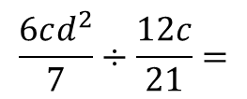
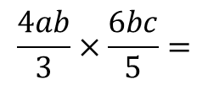
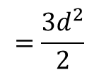

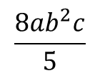
24
7
30
Date
Multiply and Divide Algebraic Fractions
EQ – How do I Simplify when Multiplying & Dividing Algebraic Fractions?
$$\frac{4ab}{3}×\frac{6bc}{5}=$$
$$\frac{8ab^{2}c}{5}$$
The 3 on the bottom will cancel with the 6 on the top and then multiply the top line then the bottom line.
$$\frac{6cd^{2}}{7}÷\frac{12c}{21}=$$
$$\frac{6cd^{2}}{7}×\frac{21}{12c}$$
Similar to Multiplication but you must change the ÷ to × then invert (tip upside down) the divisor then cancel.
$$=\frac{3d^{2}}{2}$$

Slide 6
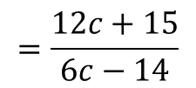
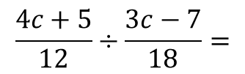
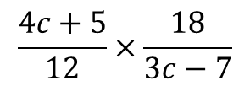
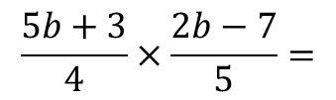
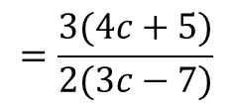
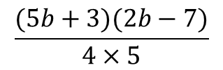
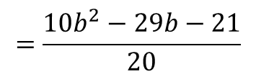
24
7
30
Date
Multiply – Divide Algebraic Fractions
EQ – How do I Simplify when Multiplying & Dividing Algebraic Fractions?
$$\frac{5b+3}{4}×\frac{2b−7}{5}=$$
$$\frac{(5b+3)(2b−7)}{4×5}$$
There is nothing to cancel so multiply top line together and bottom line together
$$=\frac{10b^{2}−29b−21}{20}$$
$$\frac{4c+5}{12}÷\frac{3c−7}{18}=$$
$$\frac{4c+5}{12}×\frac{18}{3c−7}$$
Invert the divisor cancel the 18 and 12, then multiply.
$$=\frac{3(4c+5)}{2(3c−7)}$$
$$=\frac{12c+15}{6c−14}$$

Slide 7
Exercises
Exercise 1.8 from Dwyer
All to be done with a smile on your faces.

Slide 8
Notes Review
24, 7 ,30
Date
Title
Essential question
Notes complete
Notes complete with colour and diagrams
Questions completed
Contents page filed in
Formula page filled in

Slide 9
Homework
Review your notes and write a summary answering the essential question.

